Slide 1
Discussion 10
Heaps, Advanced Trees, Exam Review

Slide 2
Priority Queues
Abstract Data Type
add(Item x)
getSmallest()
removeSmallest()

Slide 3
Heaps
Heaps are one implementation of a Priority Queue
2 important properties for min heap
Every node is ≤ its children
Heap is “complete”
Heap Demo: https://goo.gl/wBKdFQ
0
0
5
1
5
1
8
8
6
8
8
2
Incomplete

Slide 4
Heaps as Arrays
1
leftChild(k) = k*2
rightChild(k) = k*2 + 1
parent(k) = k/2
k
2
e
3
v
4
b
5
g
6
p
7
y
8
a
d
f
j
m
r
x
9
10
11
12
13
14
Key[] keys
-
k
e
v
b
g
p
y
a
d
f
j
m
r
x
0 1 2 3 4
5 6 7 8 9 10 11 12 13 14

Slide 5
Heaps (Runtime)
Operation | Runtime
add(Item x) | Θ(logN)
getSmallest() | Θ(1)
removeSmallest() | Θ(logN)

Slide 6
Tree Traversals
Level Order (DBFACEG)
Depth First
Preorder (DBACFEG)
Inorder (ABCDEFG)
Postorder (ACBEGFD)
D
B
F
A
C
E
G

Slide 7
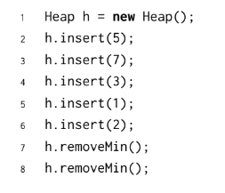

Slide 8


Slide 9
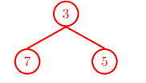

Slide 10
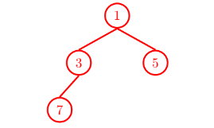

Slide 11
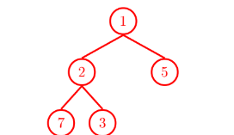

Slide 12
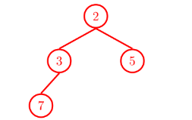

Slide 13
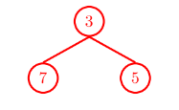

Slide 14
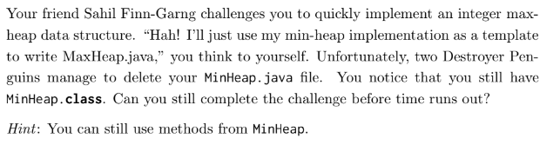

Slide 15
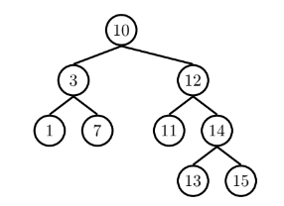
Pre-Order?
In-Order?
Post-Order?
Level-Order (BFS)?

Slide 16
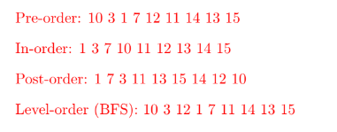

Slide 17
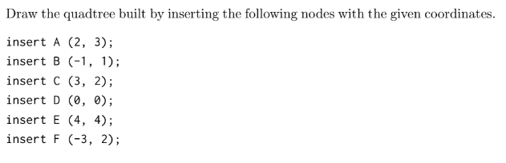

Slide 18
